Slide 1
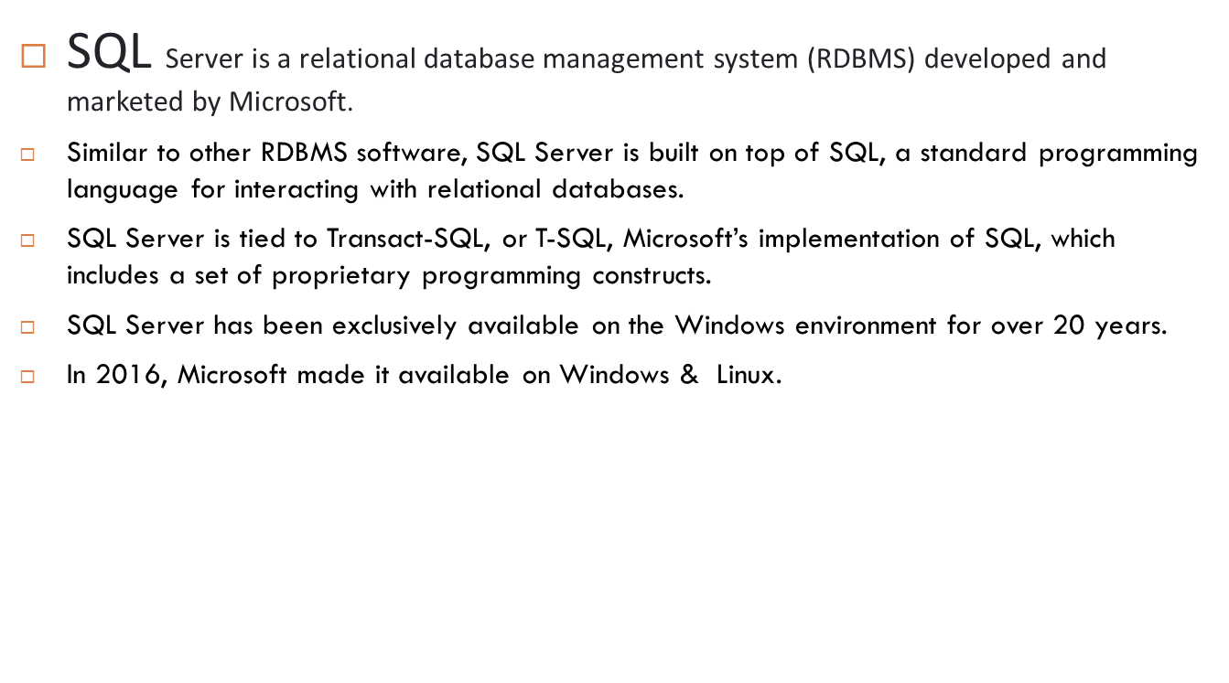
SQL SERVER OVERVIEW

Slide 2
SQL Server Services and Tools
Microsoft offers both data management and business intelligence (BI) tools and services alongside SQL Server.
For data management, SQL Server includes SQL Server Integration Services (SSIS), SQL Server Data Quality Service, and SQL Server Master Data Services.
For database development, SQL Server provides SQL Server Data tools; and for managing, deploying, and monitoring databases, SQL Server has the SQL Server Management Studio (SSMS).
For data analysis, SQL Server offers SQL Server Analysis Services (SSAS). SQL Server Reporting Services (SSRS) provides reports and data visualization. The Machine Learning Services technology first appeared first in SQL Server 2016, originally known as the R Services.

Slide 3
SQL Server Editions
SQL Server has four primary editions, each offering different bundled services and tools. Two editions are available free of charge.
SQL Server Developer Edition is intended for database development and testing purposes.
SQL Server Express Edition is suitable for small databases with a storage capacity of up to 10 GB.
For larger and more critical applications, SQL Server offers the Enterprise edition, which includes all SQL Server’s features.
SQL Server Standard Edition has a subset of features available in the Enterprise Edition and imposes limitations on the server, including restrictions on the number of processor cores and memory configurations.
SQL Server Web Edition is a good option for web hosting companies due to its low total cost of ownership.

